Slide 1
Foundation of Data Science: Project Report
Prajwal Krishna
https://github.com/prajwal2495

Slide 2
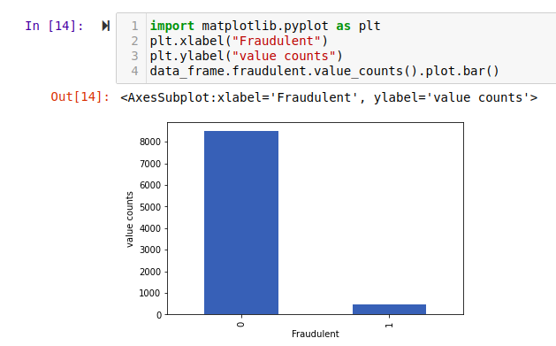
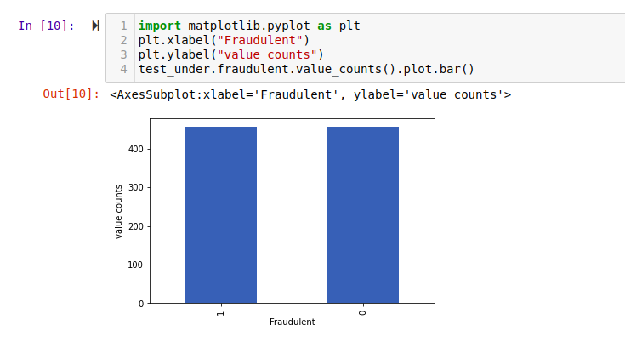
DATA ANALYSIS
Data imbalance problem
  After plotting the data, it was found that the fraudulent which is the label column is highly imbalanced as shown below
  This imbalance in data was handled while fitting the model.
https://github.com/prajwal2495

Slide 3
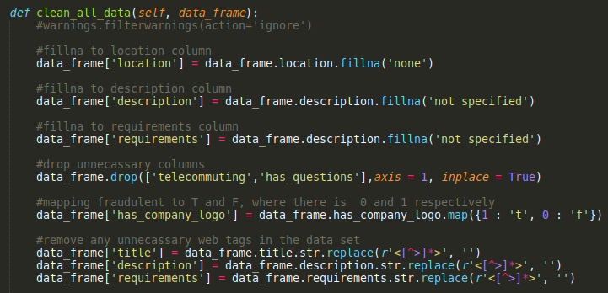
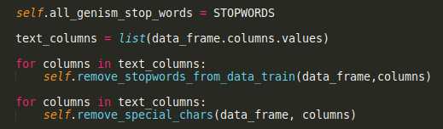
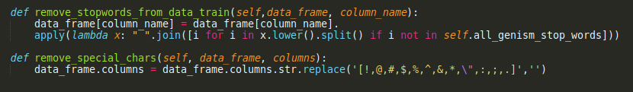
Preprocessing
FillNa on all text columns of the training data set
Removing special characters, unnecessary web tags, characters that are not words and unnecessary white spaces.
Removing STOPWORDS from the training dataset
https://github.com/prajwal2495

Slide 4

TFIDF vectorization
TFIDF vectorization has been done on cleaned data
Vectorization has been done on description and requirements columns as I decided it was the 2 columns that were giving most of the credible information
https://github.com/prajwal2495

Slide 5
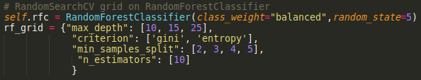
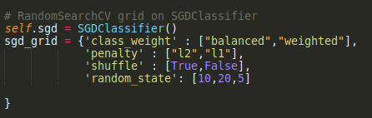
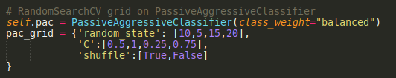
Model Selection and Tuning
Model Tuning is done on 3 models
  SGDClassifier
  RandomForestClassifier
  PassiveAgressiveClassifier
https://github.com/prajwal2495

Slide 6
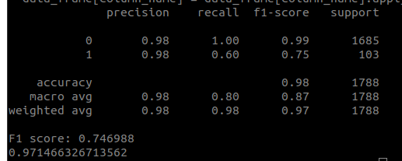
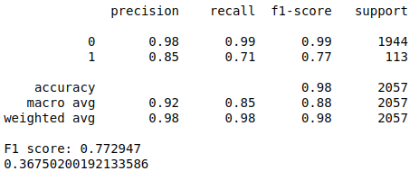
Performances of the models
SGD classifier classification report
PAC classifier
Classification report
https://github.com/prajwal2495

Slide 7
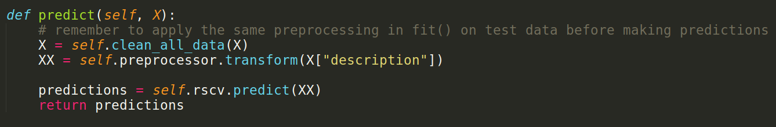
PREDICTIONS
Cleaning the testing data set with the same pre_processor
TF IDF Transformation on the testing data set
Calling predict method on the Random Search CV
https://github.com/prajwal2495

Slide 8
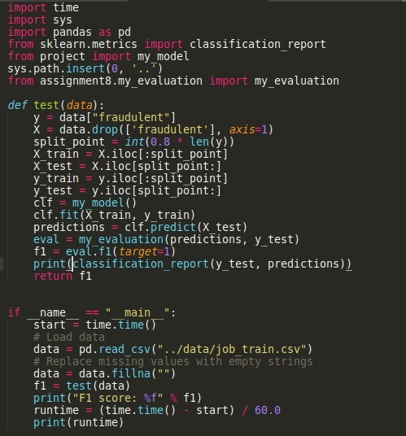
Model Evaluation
Using the Assignment 8 my_evaluation class to get the f1 score
F1 score : 0.75 - 0.77
https://github.com/prajwal2495

Slide 9
Any Questions ?
THANK YOU
https://github.com/prajwal2495

